Slide 1
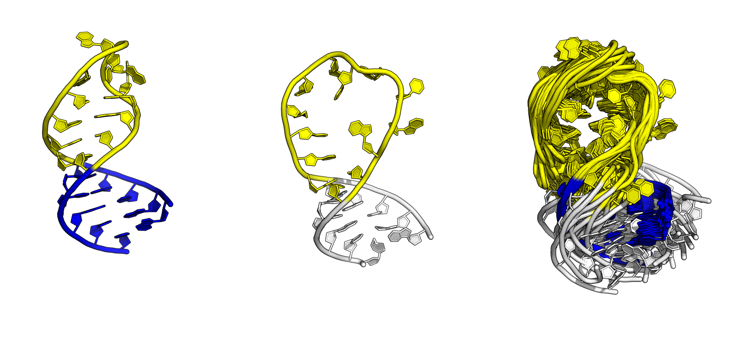
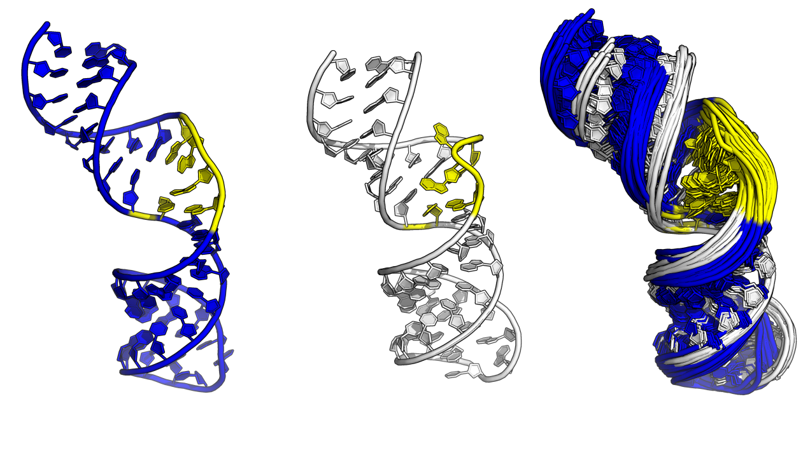
(a)
(b)
(c)
✗
✗
✗
MAE
Free
✗
✗
✗
RMSE
✗
✗
✗
MAE
Bound
✗
✗
✗
RMSE
carbon
proton
both
(d)
(e)
(f)
✗
✗
✗
MAE
(c)
Free
✗
✗
✗
RMSE
✗
✗
✗
MAE
Bound
✗
✗
✗
RMSE
carbon
proton
both
0.50
NSLR
1.00

Slide 2
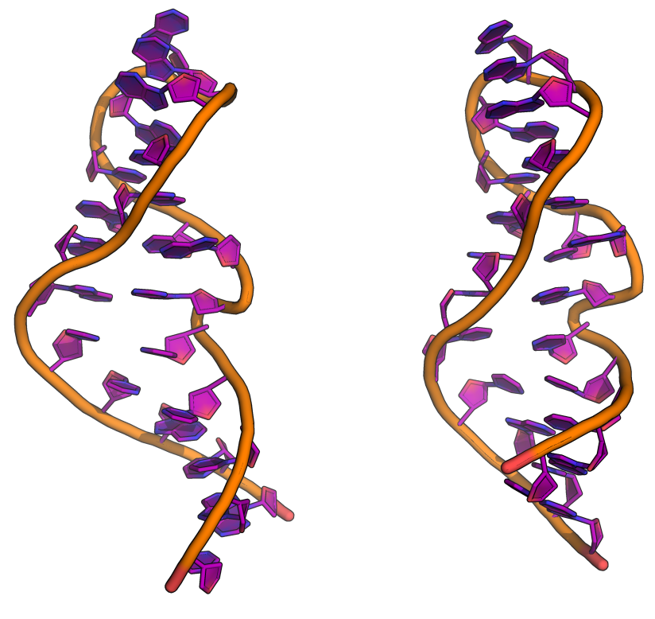
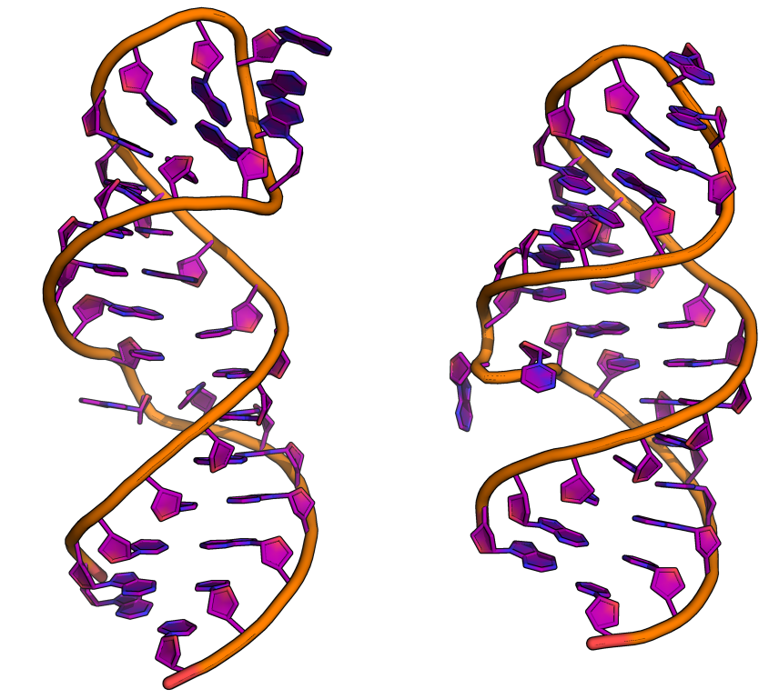
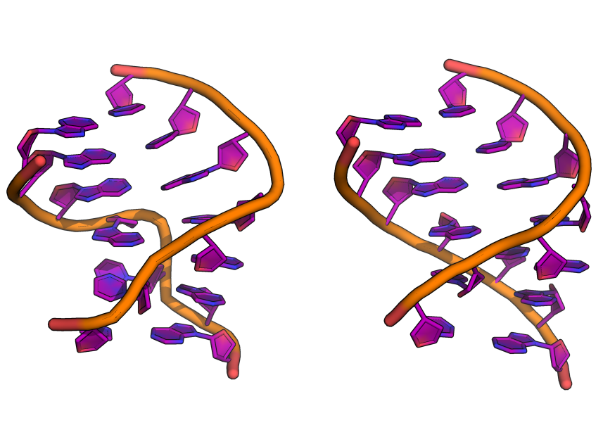
NMR
X-RAY
a
b
c
1SCL (1.24)
430D (1.18)
28SR (1.47)
1LNT (1.44)
2LPS (0.79)
1KXK (0.98)

Slide 3
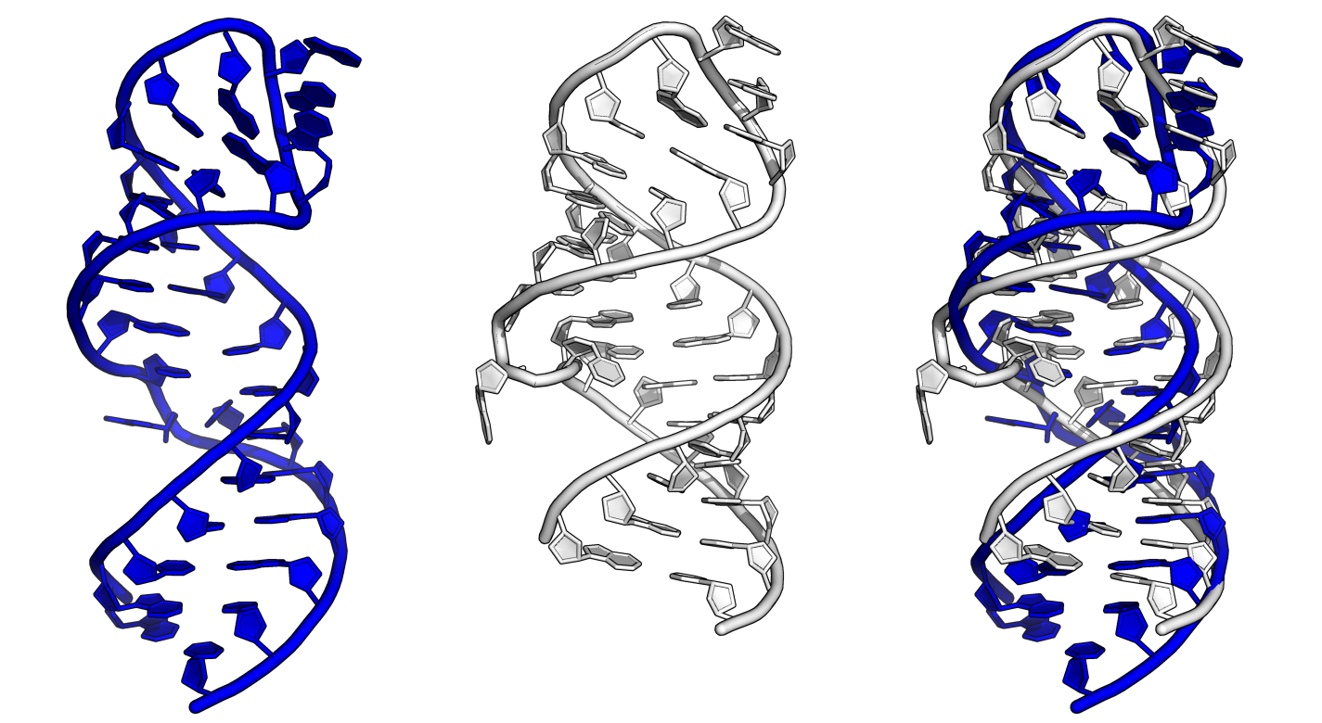
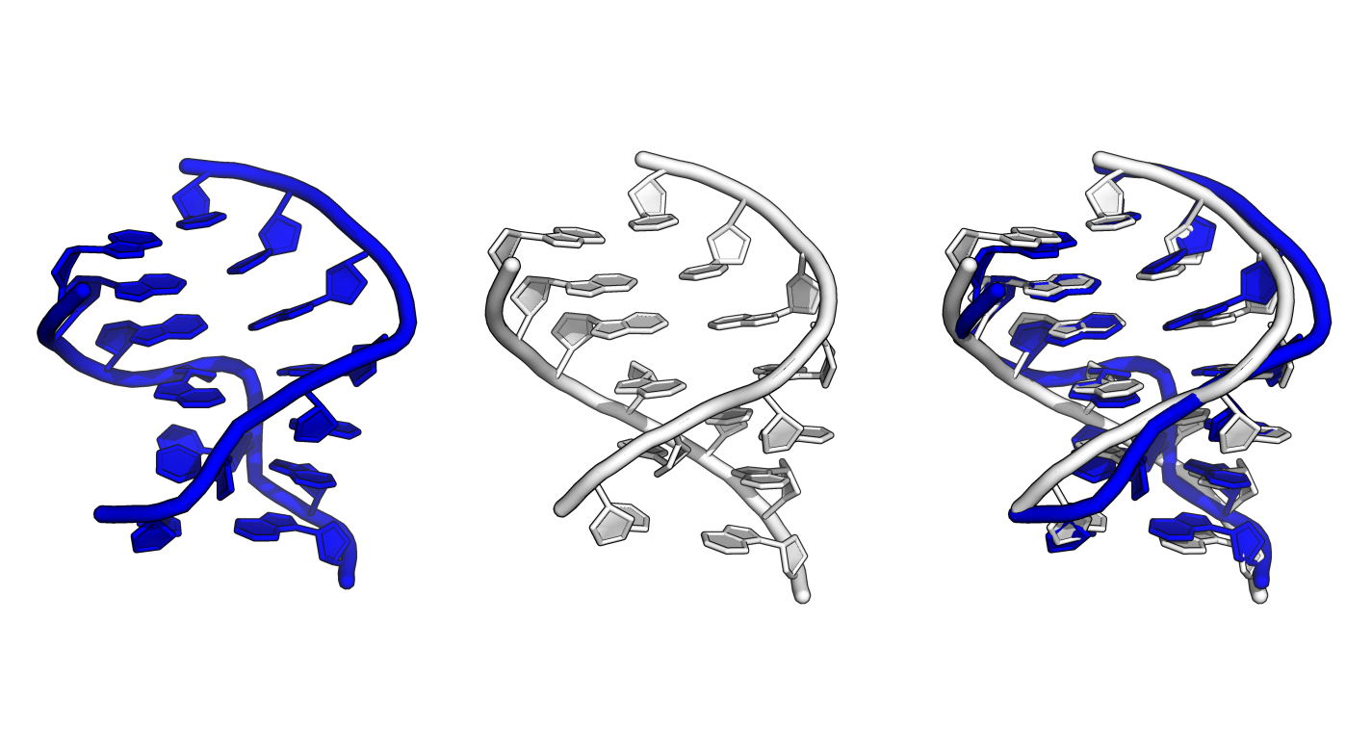
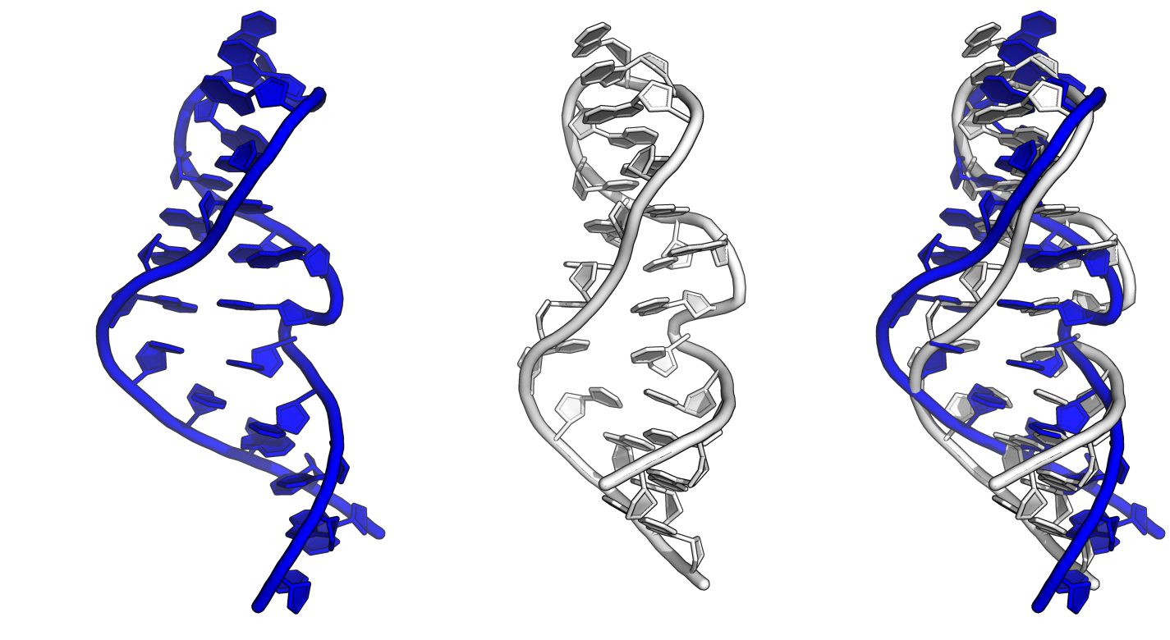
a
b
c
NMR 1SCL (0.29)
X-RAY 430D (0.31)
2LPS (0.45)
1KXK (0.37)
28SR (0.23)
1LNT (0.24)

Slide 4
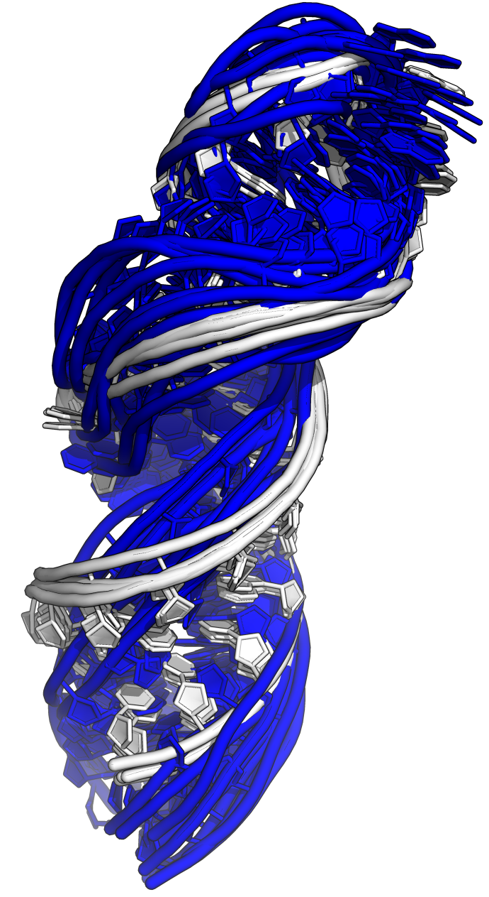
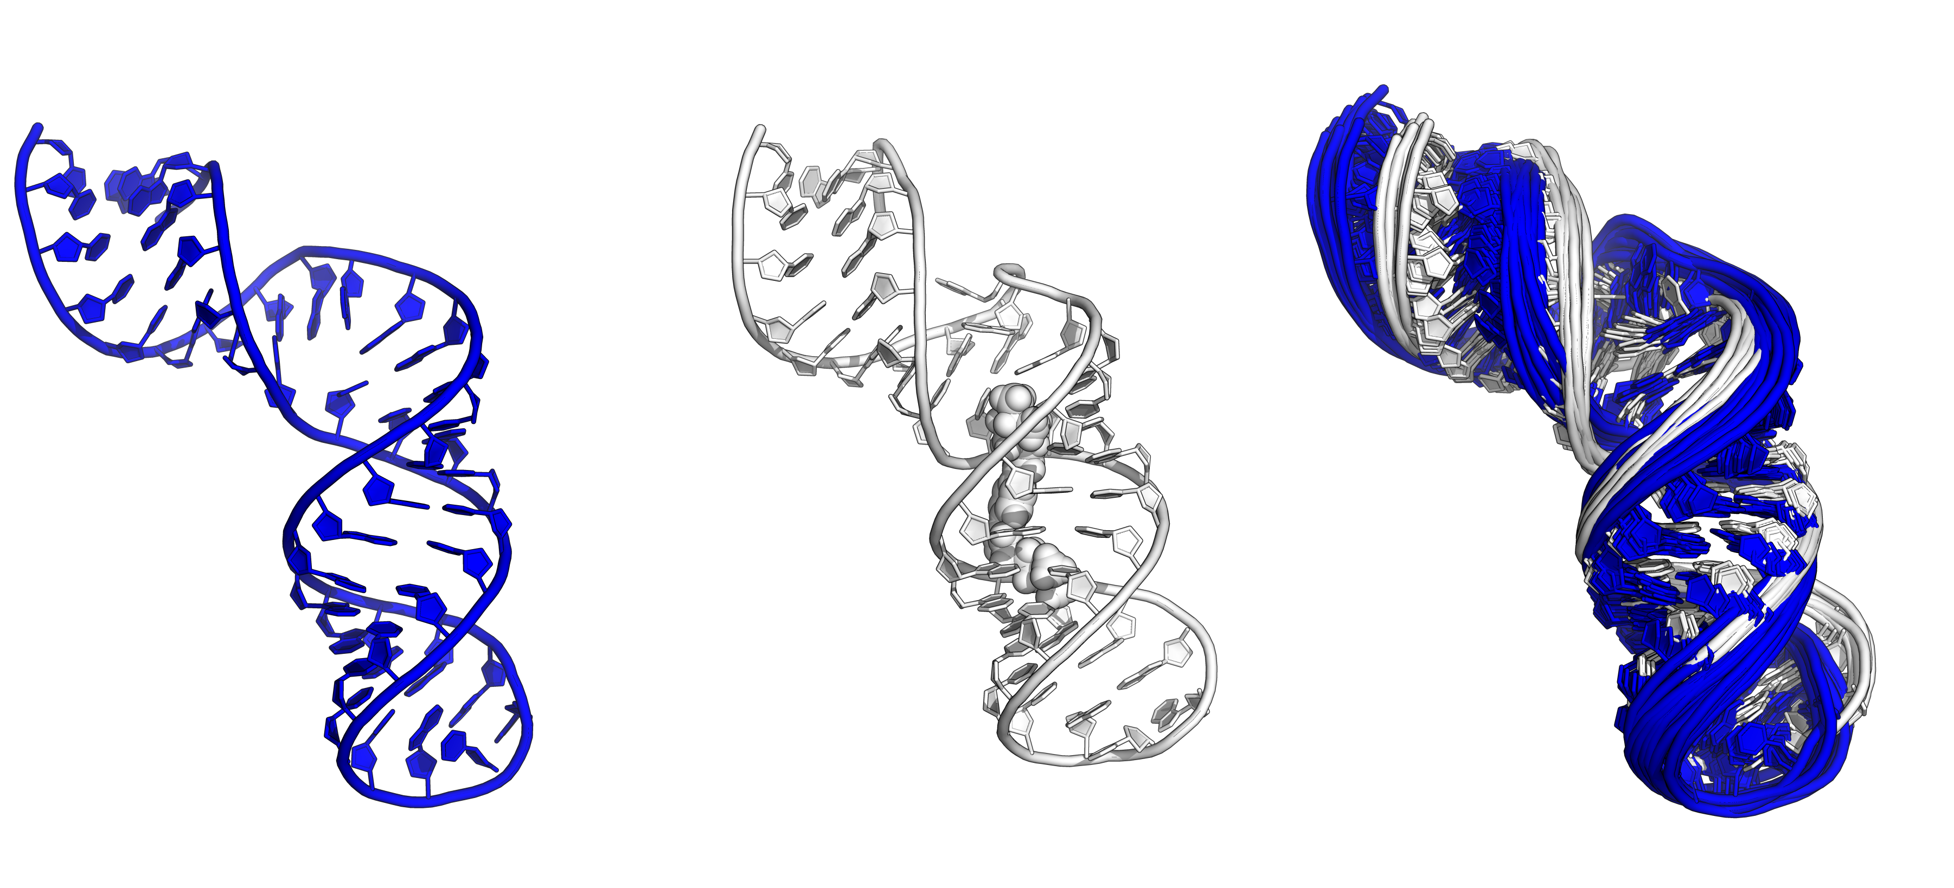
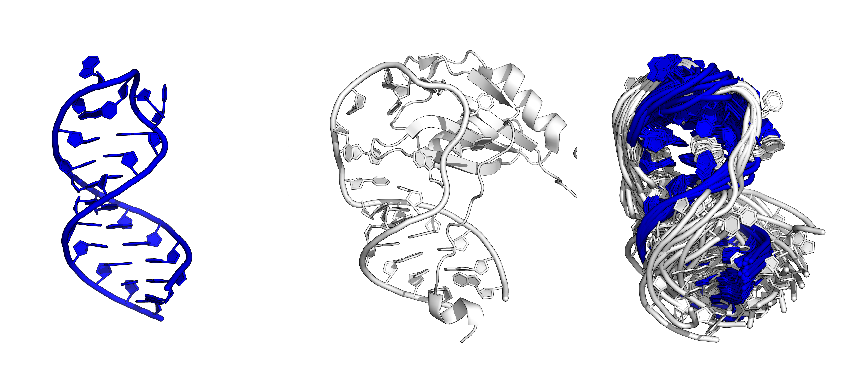
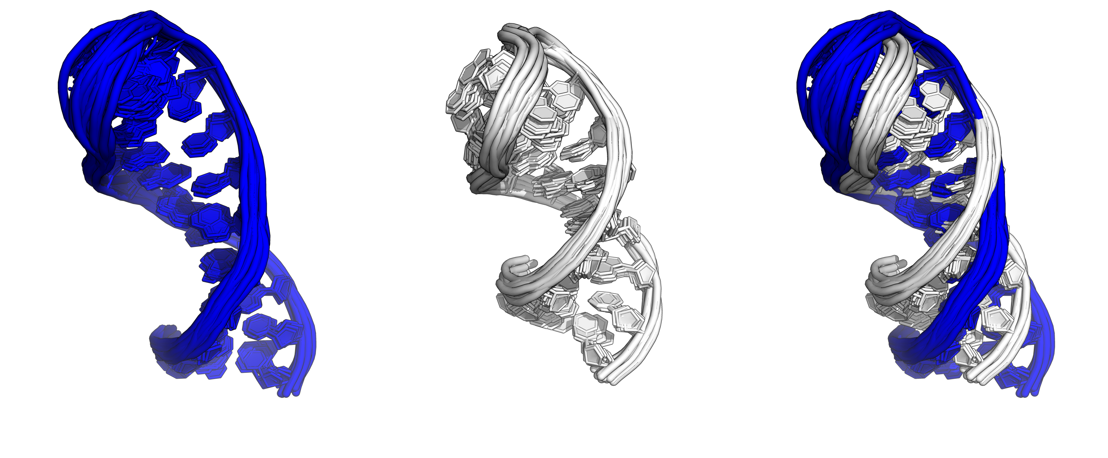
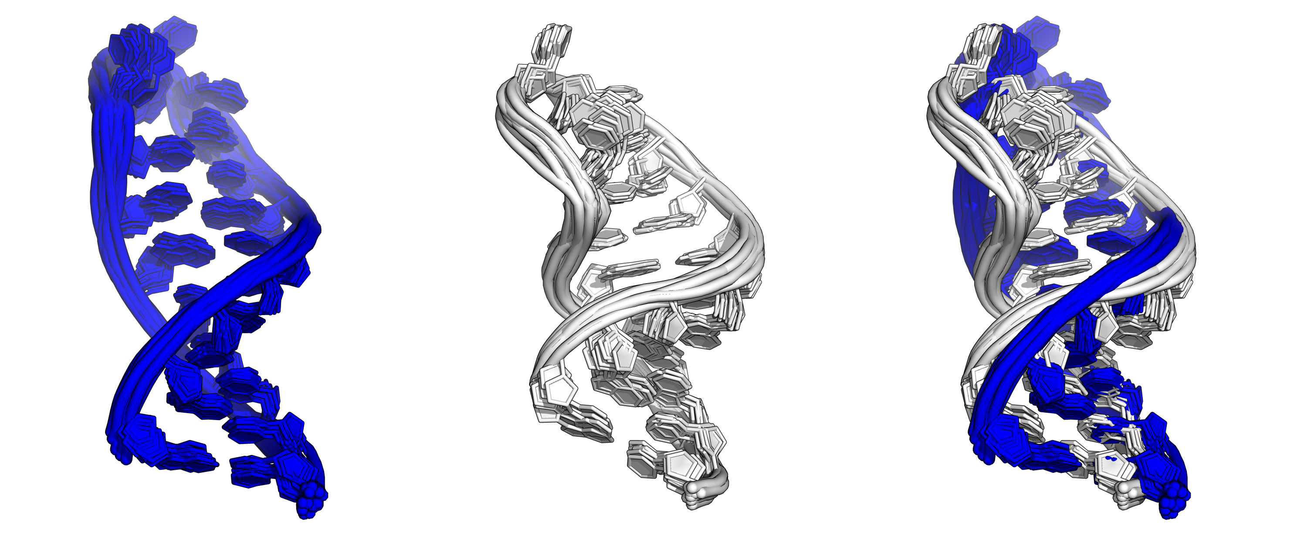
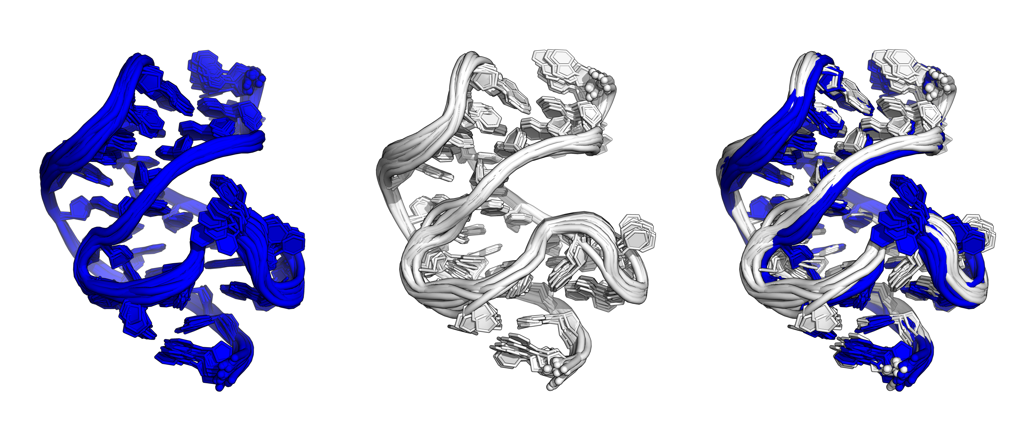
 | Average Structure | Conformational Averaging | Composite Ensembles
1R2P:2LPS | ✔ | ✔ | ✔
2FRL:2M22 | ✔ | ✔ | ✔
2HX2:2M21 | ✔ | ✔ | ✔
2KFC:2L1V | ✔ | ✔ | ✔
2L94:1Z2J | ✔ | ✗ | ✗
2N8X:2N7X | ✔ | ✔ | ✔
1Z2J:2L94 | ✔ | ✔ | ✔
2N7X:2N82 | ✗ | ✔ | ✔

Slide 5
a
b
1R2P, 2LPS
2FRL, 2M22
1Z2J, 2L94
2H2X, 2M21
2KFC, 2L1V
2N7X, 2N82

Slide 6
a
b
Resolving Power (NSLR)
Resolving Power (NSLR)
1
2
3
4
5
6
7
8
¹H
¹³C
¹H+ ¹³C
test
nuclei

Slide 7
Compare Observed and Computed Chemical Shifts
Error = 0.67
(Higher Quality)
✗
comp. chemical shifts (ppm)
comp. chemical shifts (ppm)
2KFC
obs. chemical shifts (ppm)
obs. chemical shifts (ppm)
Error = 0.67
(Higher Quality)
✔
comp. chemical shifts (ppm)
comp. chemical shifts (ppm)
2L1V
obs. chemical shifts (ppm)
obs. chemical shifts (ppm)

Slide 8
 | Average Structure | Con. Averaging | Each NMR Model
1 | ✔ ✔ ✔ | ✔ ✔ ✔ | ✔ ✔ ✔
2 | ✔ ✔ ✔ | ✔ ✔ ✔ | ✔ ✔ ✔
3 | ✔ ✔ ✔ | ✔ ✔ ✔ | ✔ ✔ ✔
4 | ✔ ✔ ✔ | ✔ ✔ ✔ | ✔ ✔ ✔
5 | ✔ ✔ ✔ | ✗ ✗ ✗ | ✗ ✗ ✗
6 | ✔ ✔ ✔ | ✔ ✔ ✔ | ✔ ✔ ✔
7 | ✔ ✔ ✔ | ✔ ✔ ✔ | ✔ ✔ ✔
8 | ✗ ✗ ✗ | ✔ ✔ ✔ | ✔ ✔ ✔
TPR

Slide 9
a
b
c
Resolving Power (NSLR)
Resolving Power (NSLR)
1
2
3
4
5
6
7
8
¹H
¹³C
¹H+ ¹³C
test
nuclei

